Slide 1

RyniXsoft
MANIKANDAN G – RXS26133
UI/UX DESIGNER

Slide 2
High-Fidelity UI Design
High-Fidelity UI Design refers to a detailed and realistic version of a user interface that closely represents the final product. It includes actual design elements such as colors, typography, images, icons, spacing, and interactive components.
Uses real colors, fonts, and styling
Includes images, icons, and detailed layouts
Represents the final look of the application
May include interactive elements (buttons, hover effects)
Designed using tools like Figma or Adobe XD

Slide 3
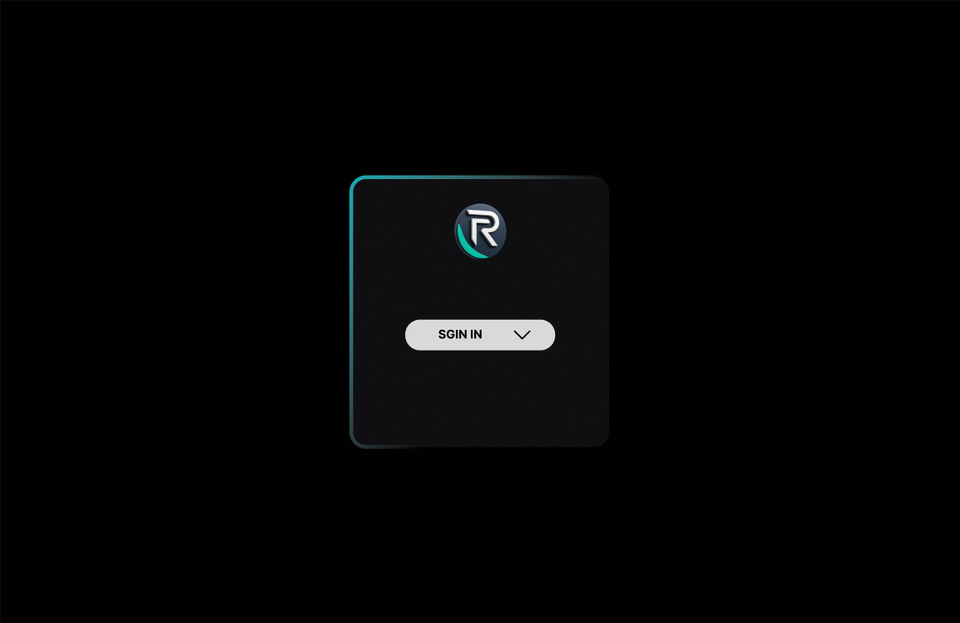
LOGIN PAGE
The login page is designed as a minimal and focused interface for user authentication.
Role-based access (HR, Team Lead, Employee)

Slide 4
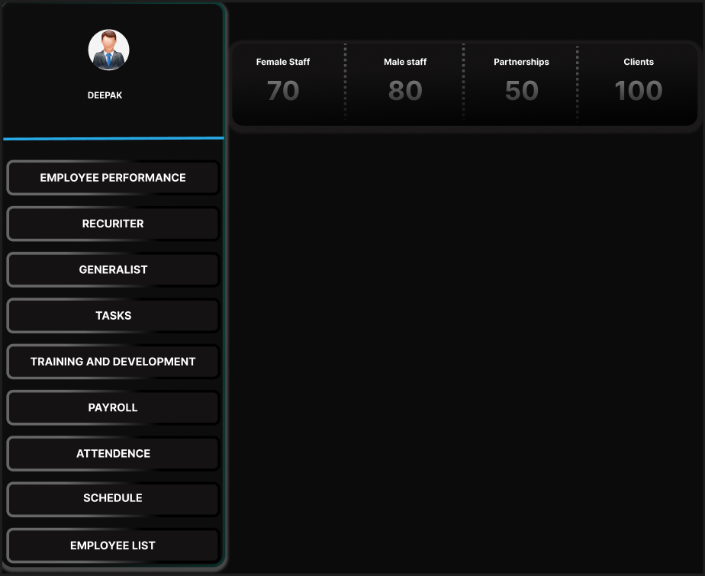
HR DASHBOARD
The HR dashboard acts as the main control panel for managing workforce data.
Sidebar navigation for easy access
Profile section
Employee statistics (Female, Male, Partnerships, Clients)
Module buttons such as:
Employee Performance
Recruiter
Tasks
Training & Development
Payroll
Attendance
Schedule

Slide 5
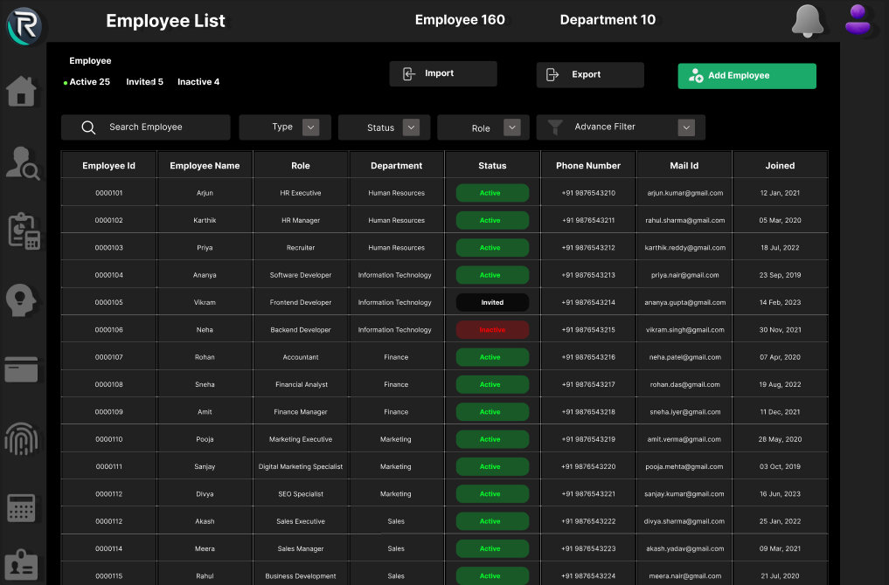
EMPLOYEE LIST
This page displays all employee records in a structured table format.
Employee details (ID, Name, Role, Department)
Status indicators (Active, Inactive)
Contact information
Import and export options
Add employee button

Slide 6
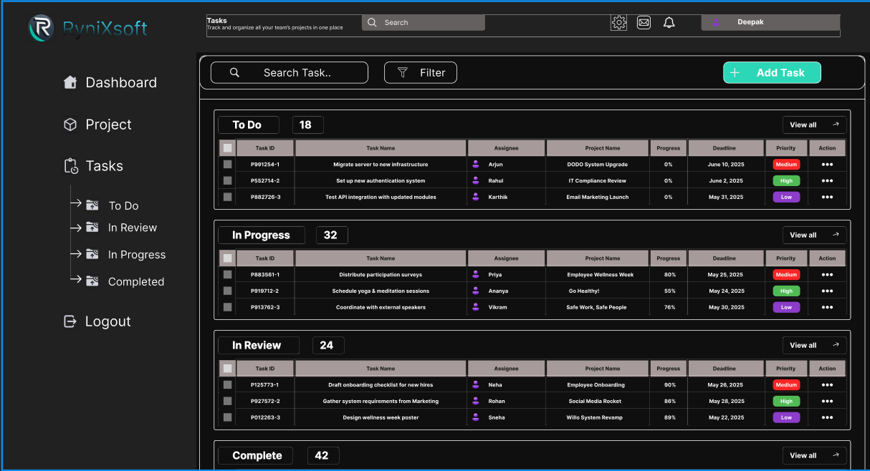
TASK PAGE
This page is designed to manage and monitor tasks across teams.
Task categories:
To Do
In Progress
In Review
Completed
Task details (Assignee, Project, Deadline, Priority)
Add task button
Search and filter functionality

Slide 7
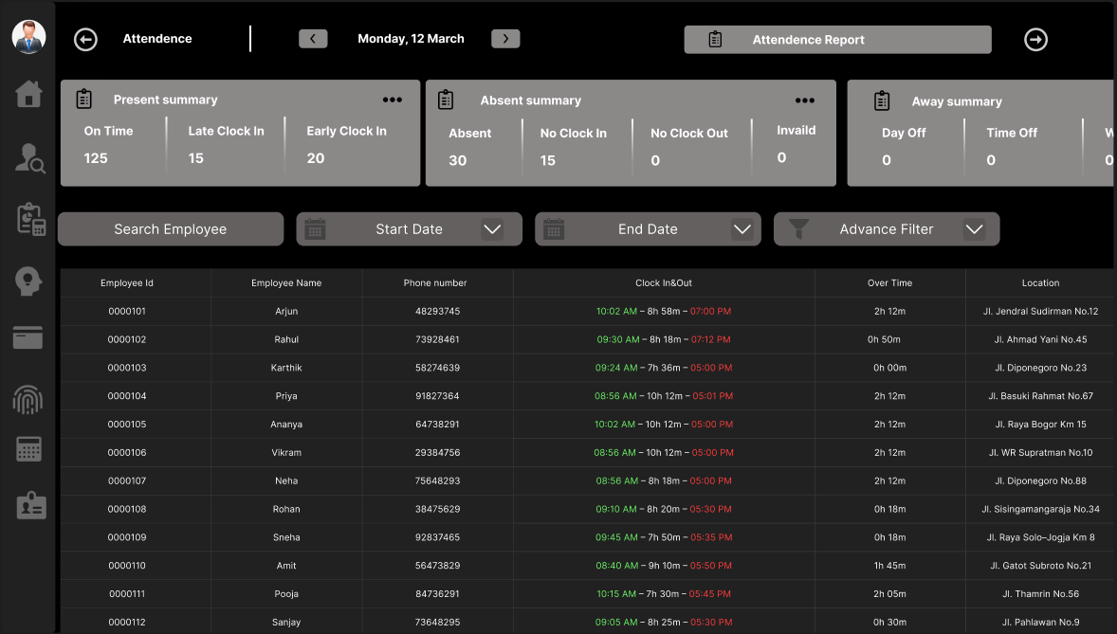
ATTENDENCE PAGE
The attendance overview page provides detailed insights into employee attendance.
Attendance summary (Present, Absent, Away)
Date navigation
Search and filter options
Attendance table with clock-in and clock-out time

Slide 8
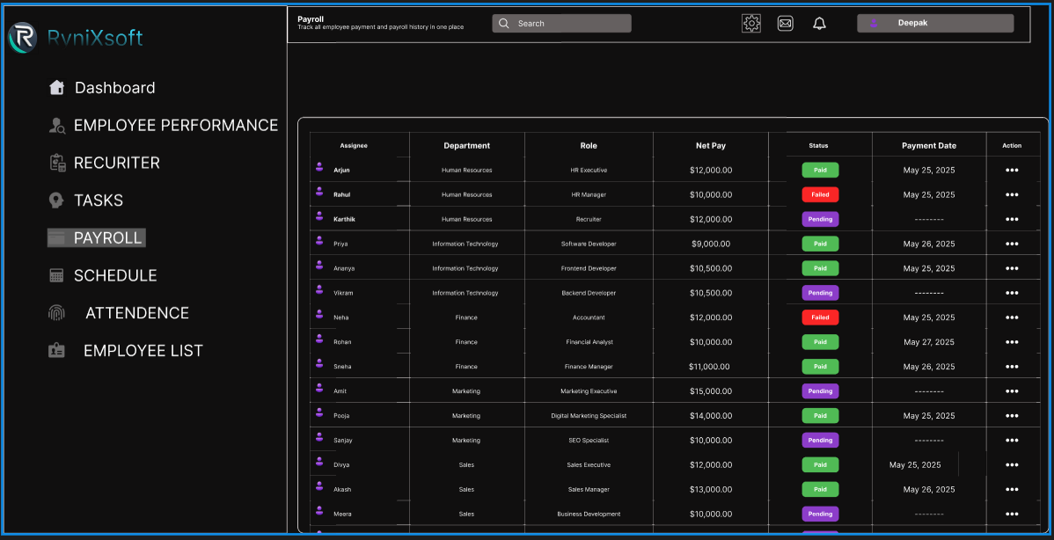
PAYROLL
This page is designed to manage and monitor tasks across teams.
Task categories:
To Do
In Progress
In Review
Completed
Task details (Assignee, Project, Deadline, Priority)
Add task button
Search and filter functionality

Slide 9
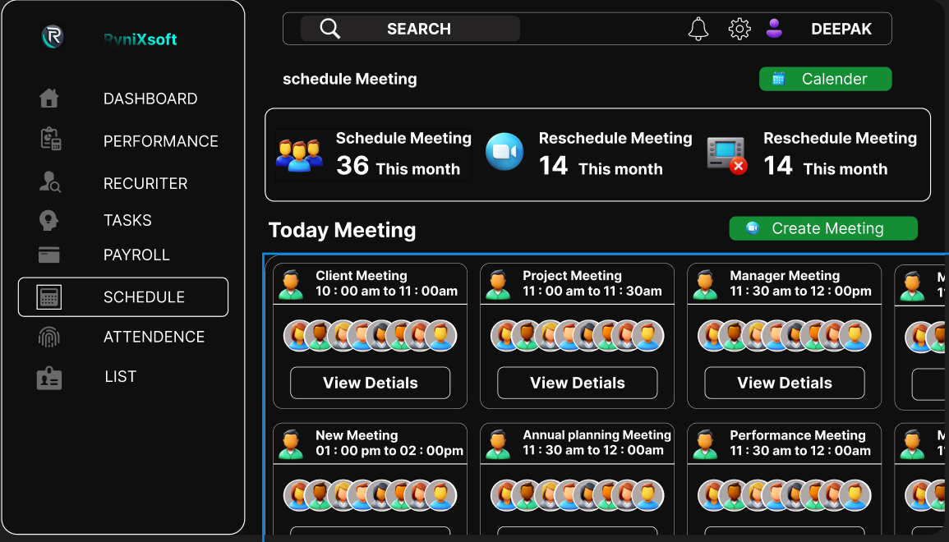
SCHEDULE PAGE
The payroll page manages employee salary and payment details.
Net pay information
Payment status (Paid, Failed, Pending)
Payment date
Salary records

Slide 10
NAVIGATION STRUCTURE
The dashboard includes a sidebar navigation menu that allows users to easily move between different sections of the platform.
The main navigation options include:
• Employee Performance • Payroll • Attendance • Schedule • Task Management

Slide 11
THANK YOU

